Slide 1
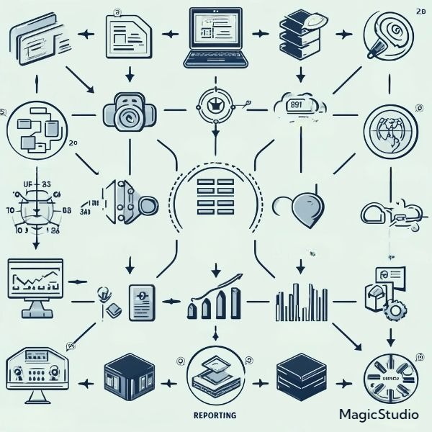
SOURCE
BASIC DATA FILES
PROCESSING SYSTEM
NEW FOCUS PROCESS
DATA STORAGE
SOURCE
DATA PROCESSING
ETL
DATA ANALYTICS PLATFORM
DATA INTEGRATION
DATA MATERIALS
PRODUCTS
PRO STORAGE
STORAGE
DATA RESEARCH
STAKEHOLDERS
DISTRIBUTION

